Slide 1


Noida Institute of Engineering and Technology, Greater Noida
Introduction To NOSQL with Cloud Database
Database Management System
ACSE0506
Unit: 5
Sana Anjum
Assistant Professor
CSE
B-Tech 5th Sem
CSE

Slide 2
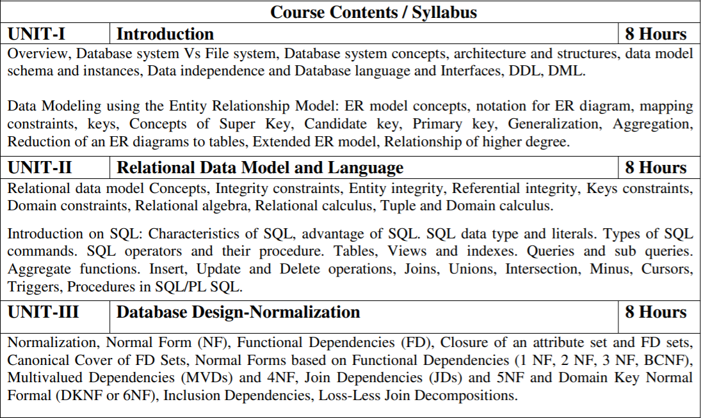
Subject Syllabus

Slide 3
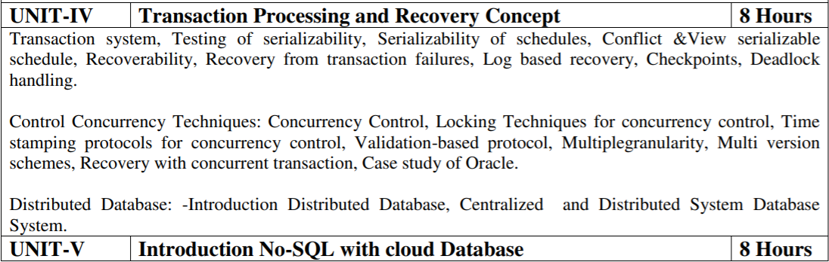
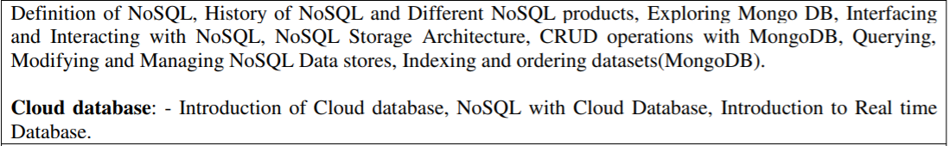
Subject Syllabus

Slide 4
Branch-wise Applications
There are various application of DBMS in different fields like Railway Reservation System, Library Management System, Banking, Universities and colleges, Credit card transactions etc.

Slide 5
Course Objectives
Present an introduction to database management systems, with an emphasis on how to organize, maintain and retrieve - efficiently, and effectively - information from a DBMS.
Differentiate between database system and file system.
Knowledge of the different models like database modeling, relational, hierarchical and network models.
Explain basic issues of transaction processing and concurrency control.

Slide 6
Course Outcomes
S. NO. | Course Outcomes | Blooms’ Taxonomy
1. | Analyze database used to solve real world and complex problem and design the ER, EER Model. | K4
2. | Analyze and apply Structured Query Language (SQL) or Procedural Query Language (PL/SQL) to solve the complex queries. Implement relational model, integrity constraints. | K3,K4
3. | Design and implement database for storing, managing data efficiently by applying the Normalization process on the database | K6
4. | Synthesize the concepts of transaction management, concurrency control and recovery | K5
5. | Understand and implement the concepts of NOSQL with cloud database | K2, K5

Slide 7
Program Outcomes
Engineering Graduates will be able to:
1. Engineering knowledge: Apply the knowledge of mathematics, science, engineering fundamentals, and an engineering specialization to the solution of complex engineering problems.
2. Problem analysis: Identify, formulate, review research literature, and analyze complex engineering problems reaching substantiated conclusions using first principles of mathematics, natural sciences, and engineering sciences.
3. Design/development of solutions: Design solutions for complex engineering problems and design system components or processes that meet the specified needs with appropriate consideration for the public health and safety, and the cultural, societal, and environmental considerations.
4. Conduct investigations of complex problems: Use research-based knowledge and research methods including design of experiments, analysis and interpretation of data, and synthesis of the information to provide valid conclusions.

Slide 8
Program Outcomes
Contd..
5. Modern tool usage: Create, select, and apply appropriate techniques, resources, and modern engineering and IT tools including prediction and modeling to complex engineering activities with an understanding of the limitations.
6. The engineer and society: Apply reasoning informed by the contextual knowledge to assess societal, health, safety, legal and cultural issues and the consequent responsibilities relevant to the professional engineering practice.
7. Environment and sustainability: Understand the impact of the professional engineering solutions in societal and environmental contexts, and demonstrate the knowledge of, and need for sustainable development.
8. Ethics: Apply ethical principles and commit to professional ethics and responsibilities and norms of the engineering practice.

Slide 9
Program Outcomes
Contd..
9. Individual and team work: Function effectively as an individual, and as a member or leader in diverse teams, and in multidisciplinary settings.
10. Communication: Communicate effectively on complex engineering activities with the engineering community and with society at large, such as, being able to comprehend and write effective reports and design documentation, make effective presentations, and give and receive clear instructions.
11. Project management and finance: Demonstrate knowledge and understanding of the engineering and management principles and apply these to one’s own work, as a member and leader in a team, to manage projects and in multidisciplinary environments.
12. Life-long learning: Recognize the need for, and have the preparation and ability to engage in independent and life-long learning in the broadest context of technological change.

Slide 10
Program Specific Outcomes
On successful completion of graduation degree the Computer Science & Engineering graduates will be able to:
PSO1: | Identify, analyze real world problems and design their ethical solutions using artificial intelligence, robotics, virtual/augmented reality, data analytics, block chain technology, and cloud computing.
PSO2: | Design and develop the hardware sensor devices and related interfacing software systems for solving complex engineering problems.
PSO3: | Understand inter-disciplinary computing techniques and to apply them in the design of advanced computing.
PSO4: | Conduct investigation of complex problems with the help of technical, managerial, leadership qualities, and modern engineering tools provided by industry-sponsored laboratories.

Slide 11
Program Educational Objectives
PEO1:To have an excellent scientific and engineering breadth so as to comprehend, analyze, design and provide sustainable solutions for real-life problems using state-of-the-art technologies.
PEO2: To have a successful career in industries, to pursue higher studies or to support entrepreneurial endeavors and to face the global challenges.
PEO3: To have an effective communication skill, professional attitude, ethical values and a desire to learn specific knowledge in emerging trends, technologies for research, innovation and product development and contribution to society.
PEO4: To have life-long learning for up-skilling and re-skilling for a successful professional career as an engineer, scientist, entrepreneur or bureaucrat for the betterment of the society.

Slide 12
CO-PO Mapping
S.No. | Cos | PO1 | PO2 | PO3 | PO4 | PO5 | PO6 | PO7 | PO8 | PO9 | PO10 | PO11 | PO12
1 | ACSE0506.1 | 2 | 3 | 3 | 3 | 2 | 1 | - | 1 | 2 | - | 2 | 2
2 | ACSE0506.2 | 3 | 2 | 3 | 3 | 2 | 2 | - | 2 | 1 | 2 | 2 | 2
3 | ACSE0506.3 | 3 | 3 | 2 | 3 | 3 | 2 | - | 2 | 1 | - | 2 | 2
4 | ACSE0506.4 | 3 | 2 | 3 | 2 | 2 | 2 | - | - | 2 | 2 | 2 | 3
5 | ACSE0506.5 | 2 | 2 | 2 | 2 | 2 | 2 | - | - | 1 | 2 | 1 | 2
6 | Average | 2.6 | 2.4 | 2.6 | 2.6 | 2.2 | 1.8 | - | 1.67 | 1.4 | 2.0 | 1.8 | 2.2

Slide 13
CO-PSO Mapping
 | PSO1 | PSO2 | PSO3 | PSO4
ACSE0506.1 | 3 | 1 | 3 | 3
ACSE0506.2 | 3 | 1 | 3 | 2
ACSE0506.3 | 3 | 2 | 2 | 2
ACSE0506.4 | 3 | 2 | 2 | 2
ACSE0506.5 | 3 | 2 | 2 | 2
Average | 3 | 1.6 | 2.4 | 2.2

Slide 14
COs and PEOs Mapping
CO-PEO Mapping
 | Program Educational Objectives
 | PEO1 | PEO2 | PEO3 | PEO4
1. | 3 | 1 | 3 | 1
2. | 3 | 1 | 3 | 1
3. | 3 | 1 | 3 | 1
4. | 3 | 1 | 3 | 1
5. | 3 | 1 | 3 | 1
AVG | 3.00 | 1.00 | 3.00 | 1.00

Slide 15
Prerequisite/Recap
Prerequisites:
Linux/ Windows operating system.
Database Management Software's such as Oracle
Knowledge on SQL/PLSQL.
Cloud Infrastructure.
Handling Big Data on Unstructured Databases.
Programming Languages (Python or Java)
Recap:
Discussion about Cloud and Database Management System.

Slide 16
Unit Content
Definition of NoSQL
History of NoSQL and Different NoSQL products
Exploring Mongo DB
Interfacing and Interacting with NoSQL
NoSQL Storage Architecture
CRUD operations with MongoDB
Querying, Modifying and Managing NoSQL Data stores
Indexing and ordering datasets (MongoDB)
Cloud database: - Introduction of Cloud database
NoSQL with Cloud Database
Introduction to Real time Database.

Slide 17
You tube Video Links
http://www.nptelvideos.com/lecture.php?id=6516
http://www.nptelvideos.com/lecture.php?id=6517
http://www.nptelvideos.com/lecture.php?id=6518
http://www.nptelvideos.com/lecture.php?id=6519
https://www.youtube.com/watch?v=2yQ9TGFpDuM

Slide 18
Unit Objectives
The objective of the Unit is :
1.To provide an overview of an exciting growing field of NOSQL databases.
2. To inculcate the preliminary knowledge of domain of DBMS and elaborate when should NoSQL be used:
When huge amount of data need to be stored and retrieved .
The relationship between the data you store is not that important
The data changing over time and is not structured.
Support of Constraints and Joins is not required at database level
The data is growing continuously, and you need to scale the database regular to handle the data.

Slide 19
Topic 1 Objectives
Objective:
In this topic we focus on There are several advantages of working with NoSQL databases such as MongoDB and Cassandra. The main advantages are high scalability and high availability. High scalability: NoSQL database such as MongoDB uses sharding for horizontal scaling.

Slide 20
Definition of No SQL(CO5)
NoSQL databases (aka "not only SQL") are non-tabular databases and store data differently than relational tables. NoSQL databases come in a variety of types based on their data model. The main types are document, key-value, wide-column, and graph. They provide flexible schemas and scale easily with large amounts of data and high user loads.
When people use the term “NoSQL database,” they typically use it to refer to any non-relational database. Some say the term “NoSQL” stands for “non SQL” while others say it stands for “not only SQL.” Either way, most agree that NoSQL databases are databases that store data in a format other than relational tables.
A NoSQL (originally referring to "non-SQL" or "non-relational") database provides a mechanism for storage and retrieval of data that is modeled in means other than the tabular relations used in relational databases. Such databases have existed since the late 1960s, but the name "NoSQL" was only coined in the early 21st century, triggered by the needs of Web 2.0 companies. NoSQL databases are increasingly used in big data and real-time web applications. NoSQL systems are also sometimes called Not only SQL to emphasize that they may support SQL-like query languages or sit alongside SQL databases in polyglot-persistent architectures

Slide 21
Introduction NoSQL
Continued
Stands for Not Only SQL.
The idea of NoSQL founded in 1998 with term lightweight Schema Less by Carlo Strozzi.
Open-source database.
NoSQL will be the future database.
Very compatible with distributed systems.
Lower cost.
High performance database.
Founded to handle huge data space.
Used by Facebook , Google , Wikipedia …

Slide 22
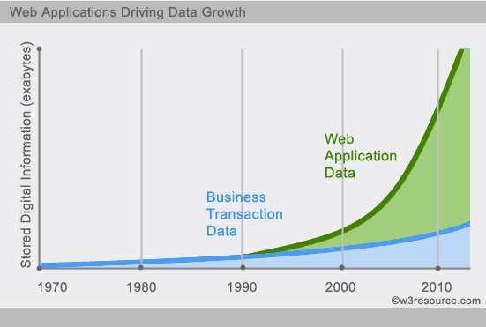
Increasing Web Application Data.
Continued

Slide 23
Characteristic of NoSQL
Continued
Large data volumes.
Scalable replication and distribution (Horizontal scaling).
Queries need to return answers quickly.
Asynchronous Inserts & Updates.
Schema-less.
Designed to support Caching without 3-rd party tools.
ACID transaction properties are not needed.
BASE here.
CAP Theorem.
No Joins statement.
No complicated Relationships
Less administration time(less cost).

Slide 24
ACID
Definition of NoSQL(CO5)
Continued
Atomic – All transaction completes (commit) or none of it completes.
Consistent – Consistency is defined in terms of constraints.
Isolated – The transaction will behave as if it is the only operation being performed upon the database
Durable – Upon completion of the transaction, the operation will not be reversed.

Slide 25
BASE
Continued
Basically Available.
Soft state(expiration of information).
Eventually Consistent.
Weak consistency.
Availability first.
Simpler and faster.

Slide 26
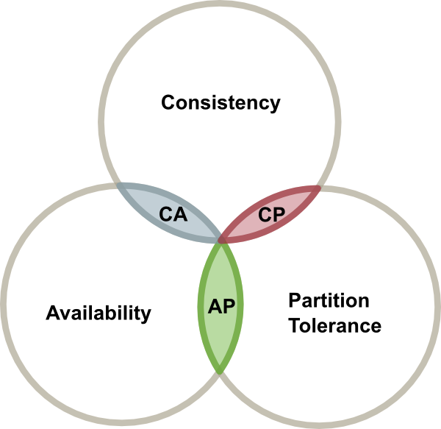
CAP Theory
CAP Theory(CO5)

Slide 27
Major NoSQL Types
NoSQL Data Types(CO5)
 Key-Value Store.
Hashing.
Basic get/put/delete.
Crazy fast because there is key to get set of values.
 Document Store.
JSON,XML … document structured.
No Join.(handle it in your code).
 Column Database.
Each storage block contains data from only one column.
Reduce access and scanning time.
Still use tables without joins statements.
Better for data analytics.

Slide 28
Developers Viewpoint !
SQL Vs NoSQL (CO5)
SQL is better ?
Natural reaction.
Everyone's experience.
Fear of change.
NoSQL Will :
Simplify your data model.
Easy to install.
your bugs will be fewer and easier to find.
Lower administration / less DBAs.
performance is going to be awesome.
Scale will be much simpler.
Rapid Development.
Large binary objects.
Graphs/relationships.

Slide 29
Look at Queries syntax
Continued
db.inventory.find( { type: "snacks" } );
db.inventory.find( { type: 'food', price: { $lt: 9.95 } } );
db.inventory.find( { producer: { company: 'ABC123', address: '123 Street' } } );
db.inventory.find( { memos: { $elemMatch: { memo : 'on time', by: 'shipping' } } } );
db.inventory.insert( { _id: 10, type: "misc", item: "card", qty: 15 } );
db.users.remove( { status: "D" } )
db.users.insert( { name: "sue", age: 26, status: "A" } )
db.users.update( { age: { $gt: 18 } }, { $set: { status: "A" }
}, { multi: true } )
db.inventory.save( { type: "book", item: "notebook", qty:
40 } )

Slide 30
What's about functions ?
var myCursor = db.inventory.find( { type: 'food' } ); myCursor.forEach(printjson);
Continued
var myCursor = db.inventory.find( { type: 'food' } ); var documentArray = myCursor.toArray();
var myDocument = documentArray[3];
Query Analysis
db.inventory.find( { type: 'food' } ).explain() Output Here

Slide 31
Summary
SQL Vs NoSQL (CO5)
NoSQL :
Handle huge data.
High availability with small cost.
More data redundancy.
High performance.
Less administration time.
Less standards.
Pick the right tool for your job !
SQL :
Good to solve ACID problems.
Expensive.
Less data redundancy.
Increasing availability mean increasing cost.
More standards.
More administration.

Slide 32
Topic 2 Objectives
Objective:
In this topic we focus on Motivations for this approach include simplicity of design, simpler "horizontal" scaling to clusters of machines (which is a problem for relational databases), finer control over availability and limiting the object-relational impedance mismatch.

Slide 33
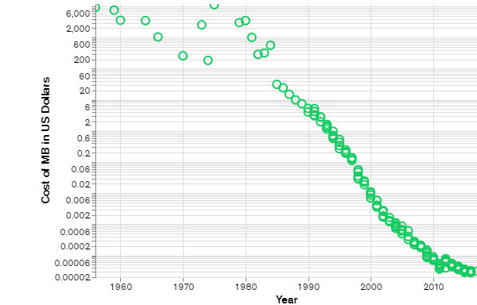
History of NoSQL and different NoSQL products (CO5)
Brief history of NoSQL databases
NoSQL databases emerged in the late 2000s as the cost of storage dramatically decreased. Gone were the days of needing to create a complex, difficult-to-manage data model in order to avoid data duplication. Developers (rather than storage) were becoming the primary cost of software development, so NoSQL databases optimized for developer productivity. Cost Per MB of Data Over Time (Log Scale)

Slide 34
Continued
As storage costs rapidly decreased, the amount of data that applications needed to store and query increased. This data came in all shapes and sizes — structured, semi-structured, and polymorphic — and defining the schema in advance became nearly impossible. NoSQL databases allow developers to store huge amounts of unstructured data, giving them a lot of flexibility.
Additionally, the Agile Manifesto was rising in popularity, and software engineers were rethinking the way they developed software. They were recognizing the need to rapidly adapt to changing requirements. They needed the ability to iterate quickly and make changes throughout their software stack — all the way down to the database. NoSQL databases gave them this flexibility.
Cloud computing also rose in popularity, and developers began using public clouds to host their applications and data. They wanted the ability to distribute data across multiple servers and regions to make their applications resilient, to scale out instead of scale up, and to intelligently geo-place their data. Some NoSQL databases like MongoDB provide these capabilities.

Slide 35
Continued
NoSQL database features
Each NoSQL database has its own unique features. At a high level, many NoSQL databases have the following features:
Flexible schemas
Horizontal scaling
Fast queries due to the data model
Ease of use for developers
Benefits of NoSQL Databases
NoSQL databases offer many benefits over relational databases. NoSQL databases have flexible data models, scale horizontally, have incredibly fast queries, and are easy for developers to work with.
1. Flexible data models
NoSQL databases typically have very flexible schemas. A flexible schema allows you to easily make changes to your database as requirements change. You can iterate quickly and continuously integrate new application features to provide value to your users faster.

Slide 36
Continued
2. Horizontal scaling
Most SQL databases require you to scale-up vertically (migrate to a larger, more expensive server) when you exceed the capacity requirements of your current server. Conversely, most NoSQL databases allow you to scale-out horizontally, meaning you can add cheaper, commodity servers whenever you need to.
3. Fast queries
Queries in NoSQL databases can be faster than SQL databases. Why? Data in SQL databases is typically normalized, so queries for a single object or entity require you to join data from multiple tables. As your tables grow in size, the joins can become expensive. However, data in NoSQL databases is typically stored in a way that is optimized for queries. The rule of thumb when you use MongoDB is Data that is accessed together should be stored together. Queries typically do not require joins, so the queries are very fast.
4. Easy for developers
Some NoSQL databases like MongoDB map their data structures to those of popular programming languages. This mapping allows developers to store their data in the same way that they use it in their application code. While it may seem like a trivial advantage, this mapping can allow developers to write less code, leading to faster development time and fewer bugs.

Slide 37
Continued
Drawbacks of NoSQL Databases
One of the most frequently cited drawbacks of NoSQL databases is that they don’t support ACID (atomicity, consistency, isolation, durability) transactions across multiple documents. With appropriate schema design, single record atomicity is acceptable for lots of applications. However, there are still many applications that require ACID across multiple records.
To address these use cases MongoDB added support for multi-document ACID transactions in the 4.0 release, and extended them in 4.2 to span sharded clusters.
Since data models in NoSQL databases are typically optimized for queries and not for reducing data duplication, NoSQL databases can be larger than SQL databases. Storage is currently so cheap that most consider this a minor drawback, and some NoSQL databases also support compression to reduce the storage footprint.
Depending on the NoSQL database type you select, you may not be able to achieve all of your use cases in a single database. For example, graph databases are excellent for analyzing relationships in your data but may not provide what you need for everyday retrieval of the data such as range queries. When selecting a NoSQL database, consider what your use cases will be and if a general purpose database like MongoDB would be a better option.

Slide 38
Continued
Types of NoSQL databases
Over time, four major types of NoSQL databases emerged: document databases, key-value databases, wide-column stores, and graph databases.
Document databases
Key-value stores
Column-oriented databases
Graph databases
Document databases store data in documents similar to JSON (JavaScript Object
Notation) objects. Each document contains pairs of fields and values. The values can typically be a variety of types including things like strings, numbers, booleans, arrays, or objects.
2. Key-value databases are a simpler type of database where each item contains keys and values.
3. Wide-column stores store data in tables, rows, and dynamic columns.
4. Graph databases store data in nodes and edges. Nodes typically store information about people, places, and things, while edges store information about the relationships between the nodes.

Slide 39
Continued
Document Databases
A document database stores data in JSON, BSON , or XML documents (not Word documents or Google docs, of course). In a document database, documents can be nested. Particular elements can be indexed for faster querying.
Documents can be stored and retrieved in a form that is much closer to the data objects used in applications, which means less translation is required to use the data in an application. SQL data must often be assembled and disassembled when moving back and forth between applications and storage.
Document databases are popular with developers because they have the flexibility to rework their document structures as needed to suit their application, shaping their data structures as their application requirements change over time. This flexibility speeds development because in effect data becomes like code and is under the control of developers. In SQL databases, intervention by database administrators may be required to change the structure of a database.
The most widely adopted document databases are usually implemented with a scale-out architecture, providing a clear path to scalability of both data volumes and traffic.

Slide 40
Continued
Use cases include ecommerce platforms, trading platforms, and mobile app development across industries.
Comparing MongoDB vs PostgreSQL offers a detailed analysis of MongoDB, the leading NoSQL database, and PostgreSQL, one of the most popular SQL databases.
Key-Value Stores
The simplest type of NoSQL database is a key-value store . Every data element in the database is stored as a key value pair consisting of an attribute name (or "key") and a value. In a sense, a key-value store is like a relational database with only two columns: the key or attribute name (such as state) and the value (such as Alaska).
Use cases include shopping carts, user preferences, and user profiles.

Slide 41
Continued
Column-Oriented Databases
While a relational database stores data in rows and reads data row by row, a column store is organized as a set of columns. This means that when you want to run analytics on a small number of columns, you can read those columns directly without consuming memory with the unwanted data. Columns are often of the same type and benefit from more efficient compression, making reads even faster. Columnar databases can quickly aggregate the value of a given column (adding up the total sales for the year, for example). Use cases include analytics.
Unfortunately, there is no free lunch, which means that while columnar databases are great for analytics, the way in which they write data makes it very difficult for them to be strongly consistent as writes of all the columns require multiple write events on disk. Relational databases don't suffer from this problem as row data is written contiguously to disk.

Slide 42
Continued
Graph Databases
A graph database focuses on the relationship between data elements. Each element is stored as a node (such as a person in a social media graph). The connections between elements are called links or relationships. In a graph database, connections are first-class elements of the database, stored directly. In relational databases, links are implied, using data to express the relationships.
A graph database is optimized to capture and search the connections between data elements, overcoming the overhead associated with Joining multiple tables in SQL.
Very few real-world business systems can survive solely on graph queries. As a result graph databases are usually run alongside other more traditional databases.
Use cases include fraud detection, social networks, and knowledge graphs.
As you can see, despite a common umbrella, NoSQL databases are diverse in their data structures and their applications.

Slide 43
Topic 3 Objectives
Objective:
In this topic we focus on MongoDB which is a source-available cross-platform document-oriented database program. Classified as a NoSQL database program, MongoDB uses JSON-like documents with optional schemas. MongoDB is developed by MongoDB Inc. and licensed under the Server Side Public License.

Slide 44
About MongoDB
Mongo DB(CO5)
MongoDB is an open-source document database and leading NoSQL database. MongoDB is written in C++.
This study will give you great understanding on MongoDB concepts needed to create and deploy a highly scalable and performance-oriented database.

Slide 45
MongoDB
Continued
MongoDB is a cross-platform, document oriented database that provides, high performance, high availability, and easy scalability. MongoDB works on concept of collection and document.
Database
Database is a physical container for collections. Each database gets its own set of files on the file system. A single MongoDB server typically has multiple databases.
Collection
Collection is a group of MongoDB documents. It is the equivalent of an RDBMS table. A collection exists within a single database. Collections do not enforce a schema. Documents within a collection can have different fields. Typically, all documents in a collection are of similar or related purpose.
Document
A document is a set of key-value pairs. Documents have dynamic schema. Dynamic schema means that documents in the same collection do not need to have the same set of fields or structure, and common fields in a collection's documents may hold different types of data.
The following table shows the relationship of RDBMS terminology with MongoDB.

Slide 46
Continued
RDBMS | MongoDB
Database | Database
Table | Collection
Tuple/Row | Document
column | Field
Table Join | Embedded Documents
Primary Key | Primary Key (Default key _id provided by mongodb itself)
Database Server and Client
Mysqld/Oracle | mongod
mysql/sqlplus | mongo

Slide 47
Continued
Name comes from “Humongous” & huge data
Written in C++, developed in 2009
Creator: 10gen, former doublick

Slide 48
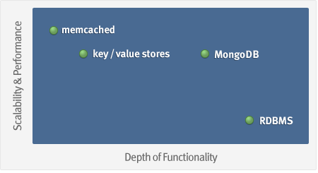
MongoDB: Goal
Continued
Goal: bridge the gap between key-value stores (which are fast and scalable) and relational databases (which have rich functionality).

Slide 49
What is MongoDB?
Continued
Definition: MongoDB is an open source, document-oriented database designed with both scalability and developer agility in mind.
Instead of storing your data in tables and rows as you would with a relational database, in MongoDB you store JSON-like documents with dynamic schemas (schema-free, schemaless).

Slide 50
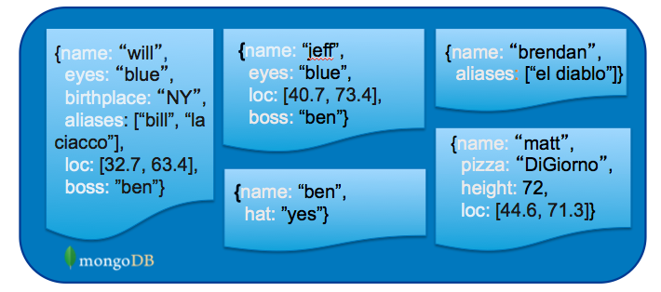
What is MongoDB?
Continued
Document-Oriented DB
Unit object is a document instead of a row (tuple) in relational DBs

Slide 51
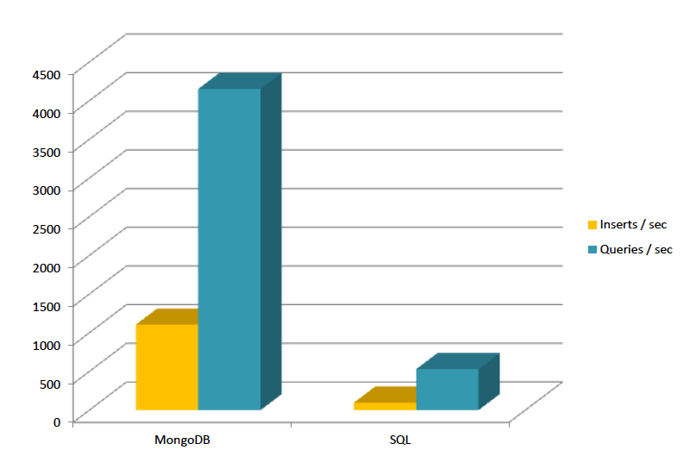
Is It Fast?
Continued
For semi-structured & complex relationships: Yes

Slide 52
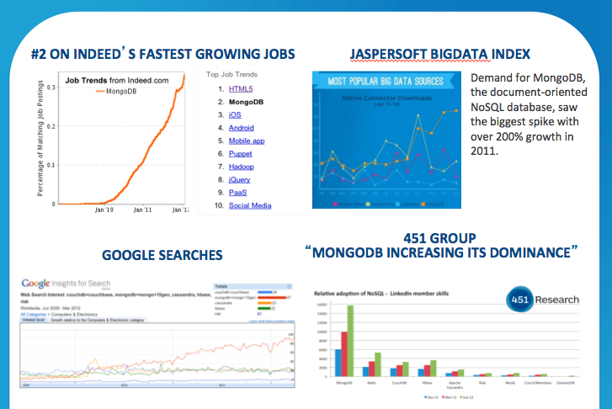
It is Growing Fast
Continued

Slide 53
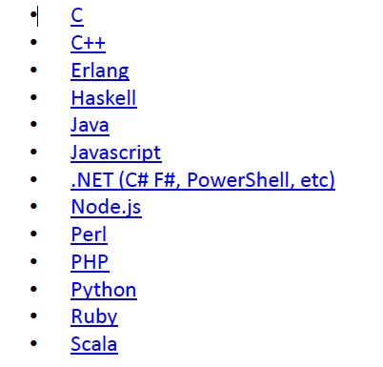
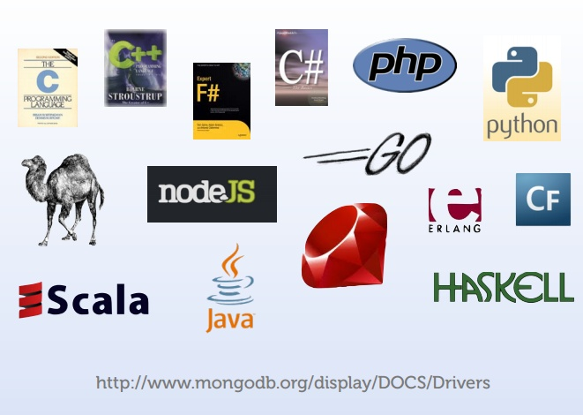
Integration with Others
Continued

Slide 54
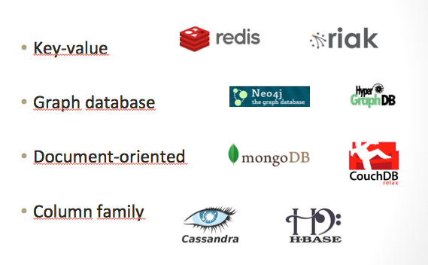
NoSQL: Categories
No SQL Categories(CO5)

Slide 55
Topic 4 Objectives
Objective:
In this topic we focus on introducing the essential ways of interacting with NoSQL data stores. The types of NoSQL stores vary and so do the ways of accessing and interacting with them. This topic attempts to summarize a few of the most prominent of these disparate ways of accessing and querying data in NoSQL databases.

Slide 56

Interfacing and Interacting with No SQL(CO5)
Objective:
In this topic we focus on MongoDB - Datatypes
String − This is the most commonly used datatype to store the data.
Integer − This type is used to store a numerical value. ...
Boolean − This type is used to store a boolean (true/ false) value.
Double − This type is used to store floating point values.
Recap:
Revision of Nosql Databases.

Slide 57
Data Types(CO5)
MongoDB supports many datatypes. Some of them are −
String − This is the most commonly used datatype to store the data. String in MongoDB must be UTF-8 valid.
Integer − This type is used to store a numerical value. Integer can be 32 bit or 64 bit depending upon your server.
Boolean − This type is used to store a boolean (true/ false) value.
Double − This type is used to store floating point values.
Min/ Max keys − This type is used to compare a value against the lowest and highest BSON elements.
Arrays − This type is used to store arrays or list or multiple values into one key.
Timestamp − ctimestamp. This can be handy for recording when a document has been modified or added.
Object − This datatype is used for embedded documents.
Null − This type is used to store a Null value.
Symbol − This datatype is used identically to a string; however, it's generally reserved for languages that use a specific symbol type.

Slide 58
Data Model
Continued
BSON format (binary JSON)
Developers can easily map to modern object-oriented languages without a complicated ORM layer.
lightweight, traversable, efficient.

Slide 59
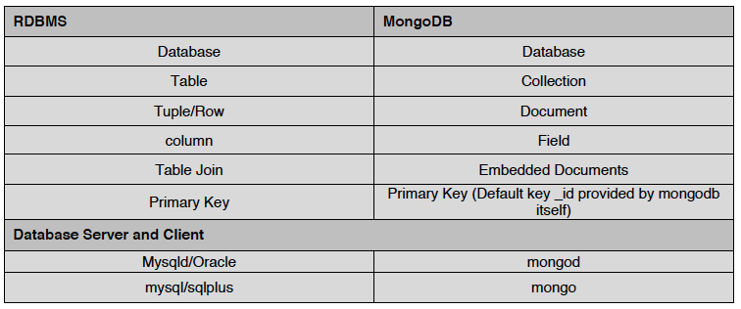
Terms Mapping (DB vs. MongoDB)
DB Vs MONGO DB(CO5)

Slide 60
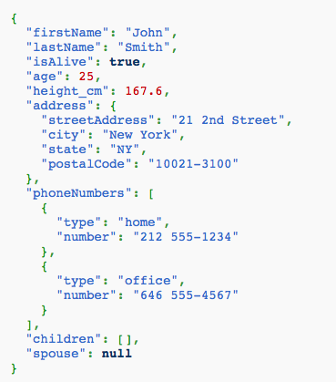
JSON
Data Types(CO5)
Field Name
Field Value
Field Value
Scalar (Int, Boolean, String, Date, …)
Document (Embedding or Nesting)
Array of JSON objects
One document

Slide 61
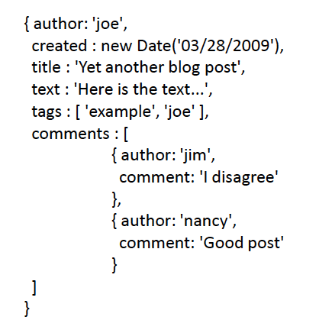
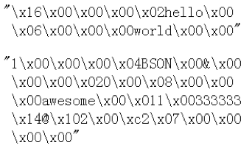
Another Example
Continued
Remember it is stored in binary formats (BSON)

Slide 62
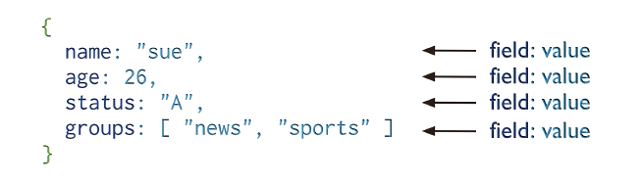
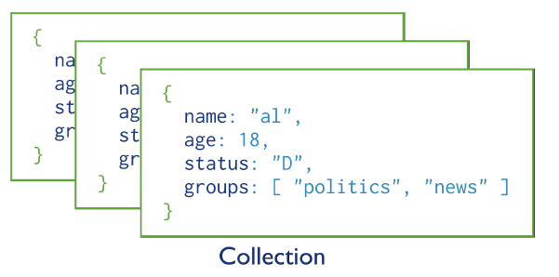
MongoDB Model
Continued
One document (e.g., one tuple in RDBMS)
Collection is a group of similar documents
Within a collection, each document must have a unique Id
One Collection (e.g., one Table in RDBMS)
Unlike RDBMS:
No Integrity Constraints in MongoDB

Slide 63
MongoDB Model
Continued
One document (e.g., one tuple in RDBMS)
The field names cannot start with the $ character
The field names cannot contain the . character
Max size of single document 16MB
One Collection (e.g., one Table in RDBMS)

Slide 64
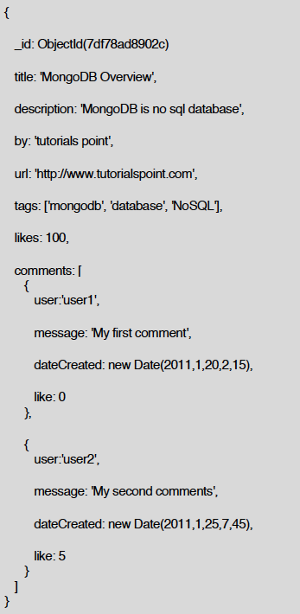
Example Document in MongoDB
Continued
_id is a special column in each document
Unique within each collection
_id ⬅➔ Primary Key in RDBMS
_id is 12 Bytes, you can set it yourself
Or:
1st 4 bytes ➔ timestamp
Next 3 bytes ➔ machine id
Next 2 bytes ➔ Process id
Last 3 bytes ➔ incremental values

Slide 65
Topic 5 Objectives
Objective:
In this topic we focus on the NoSQL database approach which is characterized by a move away from the complexity of SQL based servers. The logic of validation, access control, mapping querieable indexed data, correlating related data, conflict resolution, maintaining integrity constraints, and triggered procedures is moved out of the database layer.

Slide 66
No SQL Storage Architecture(CO5)
Architecture Pattern is a logical way of categorizing data that will be stored on the Database. NoSQL is a type of database which helps to perform operations on big data and store it in a valid format. It is widely used because of its flexibility and a wide variety of services.
Architecture Patterns of NoSQL.
The data is stored in NoSQL in any of the following four data architecture patterns:
1. Key-Value Store Database
2. Column Store Database
3. Document Database
4. Graph Database

Slide 67
Continued
These are explained as following below.
1. Key-Value Store Database:
This model is one of the most basic models of NoSQL databases. As the name suggests, the data is stored in form of Key-Value Pairs. The key is usually a sequence of strings, integers or characters but can also be a more advanced data type. The value is typically linked or co-related to the key. The key-value pair storage databases generally store data as a hash table where each key is unique. The value can be of any type (JSON, BLOB(Binary Large Object), strings, etc). This type of pattern is usually used in shopping websites or e-commerce applications.
Advantages:
Can handle large amounts of data and heavy load,
Easy retrieval of data by keys.
Limitations:

Slide 68
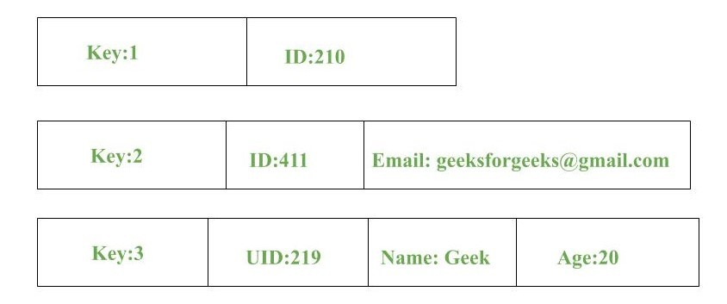
Continued
Complex queries may attempt to involve multiple key-value pairs which may delay performance.
Data can be involving many-to-many relationships which may collide.
Examples:
DynamoDB
Berkeley DB

Slide 69
Continued
2. Column Store Database:
Rather than storing data in relational tuples, the data is stored in individual cells which are further grouped into columns. Column-oriented databases work only on columns. They store large amounts of data into columns together. Format and titles of the columns can diverge from one row to other. Every column is treated separately. But still, each individual column may contain multiple other columns like traditional databases.
Basically, columns are mode of storage in this type.
Advantages:
Data is readily available
Queries like SUM, AVERAGE, COUNT can be easily performed on columns.
Examples:
HBase
Bigtable by Google
Cassandra

Slide 70
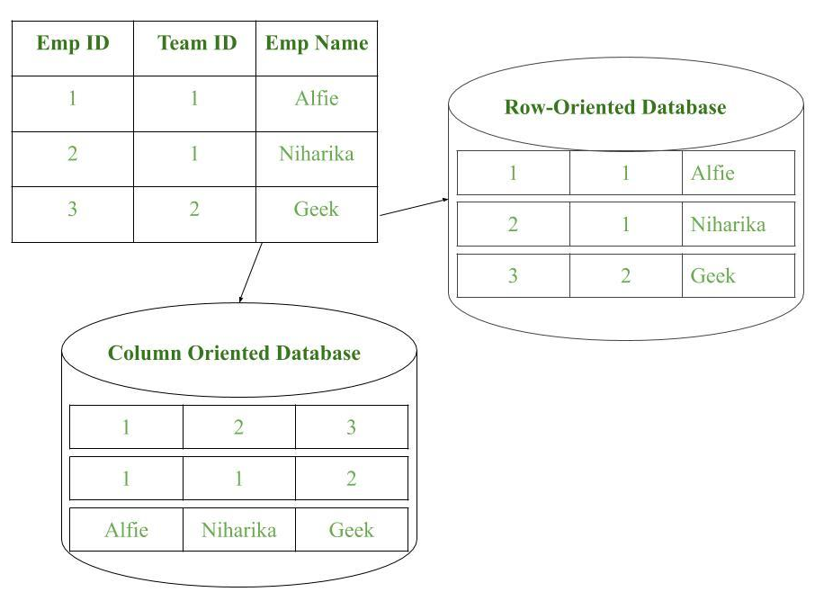
Continued

Slide 71
Continued
3. Document Database:
The document database fetches and accumulates data in form of key-value pairs but here, the values are called as Documents. Document can be stated as a complex data structure. Document here can be a form of text, arrays, strings, JSON, XML or any such format. The use of nested documents is also very common. It is very effective as most of the data created is usually in form of JSONs and is unstructured.
Advantages:
This type of format is very useful and apt for semi-structured data.
Storage retrieval and managing of documents is easy.
Limitations:
Handling multiple documents is challenging
Aggregation operations may not work accurately.
Examples:
MongoDB
CouchDB

Slide 72
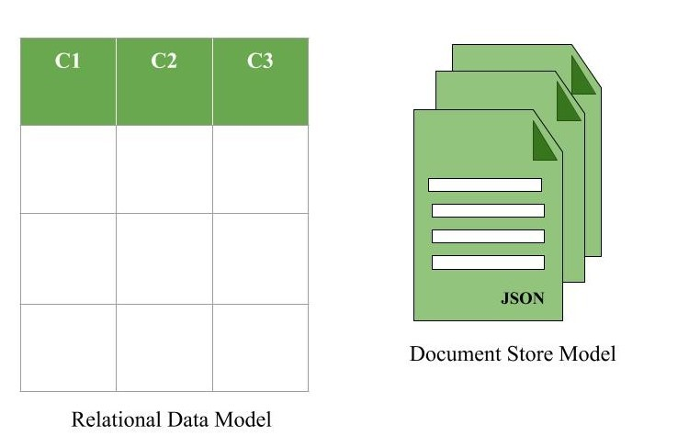
Continued
Figure – Document Store Model in form of JSON documents

Slide 73
Continued
4. Graph Databases:
Clearly, this architecture pattern deals with the storage and management of data in graphs. Graphs are basically structures that depict connections between two or more objects in some data. The objects or entities are called as nodes and are joined together by relationships called Edges. Each edge has a unique identifier. Each node serves as a point of contact for the graph. This pattern is very commonly used in social networks where there are a large number of entities and each entity has one or many characteristics which are connected by edges. The relational database pattern has tables that are loosely connected, whereas graphs are often very strong and rigid in nature.
Advantages:
Fastest traversal because of connections.
Spatial data can be easily handled.
Limitations:
Wrong connections may lead to infinite loops.
Examples:
Neo4J
FlockDB( Used by Twitter)

Slide 74
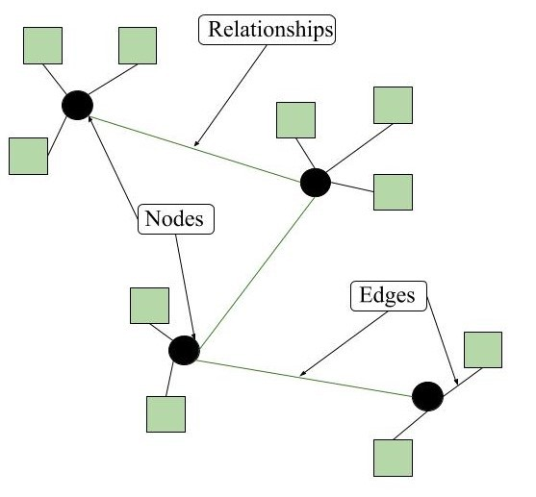
Graph Model (CO5)
Figure – Graph model format of NoSQL Databases

Slide 75
Topic 6 Objectives
Objective:
In this topic we focus on CRUD Meaning: CRUD is an acronym that comes from the world of computer programming and refers to the four functions that are considered necessary to implement a persistent storage application: create, read, update and delete.

Slide 76



Must Practice It
CRUD Operations (CO5)
Install it
Practice simple stuff
Move to complex stuff
Install it from here: http://www.mongodb.org
Manual: http://docs.mongodb.org/master/MongoDB-manual.pdf
(Focus on Ch. 3, 4 for now)
Dataset: http://docs.mongodb.org/manual/reference/bios-example-collection/

Slide 77
CRUD
CRUD Operations with Mongo DB (CO5)
Create
db.collection.insert( <document> )
db.collection.save( <document> )
db.collection.update( <query>, <update>, { upsert: true } )
Read
db.collection.find( <query>, <projection> )
db.collection.findOne( <query>, <projection> )
Update
db.collection.update( <query>, <update>, <options> )
Delete
db.collection.remove( <query>, <justOne> )

Slide 78
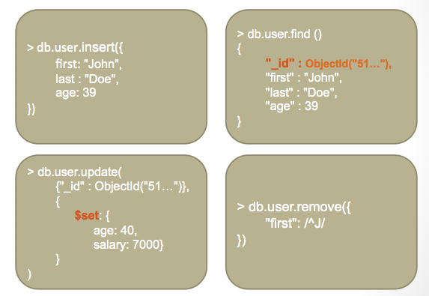
CRUD Examples
Continued

Slide 79
Topic 7 Objectives
Objective:
In this topic we focus on Most NoSQL and NewSQL data stores which implement some sort of horizontal partitioning or sharding, which involves storing sets or rows/records into different segments (or shards) which may be located on different servers.

Slide 80
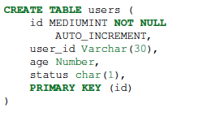


Examples
Querying, Modifying and Managing No SQL Data Stores(CO5)
In RDBMS
In MongoDB
Either insert the 1st document
Or create “Users” collection explicitly

Slide 81
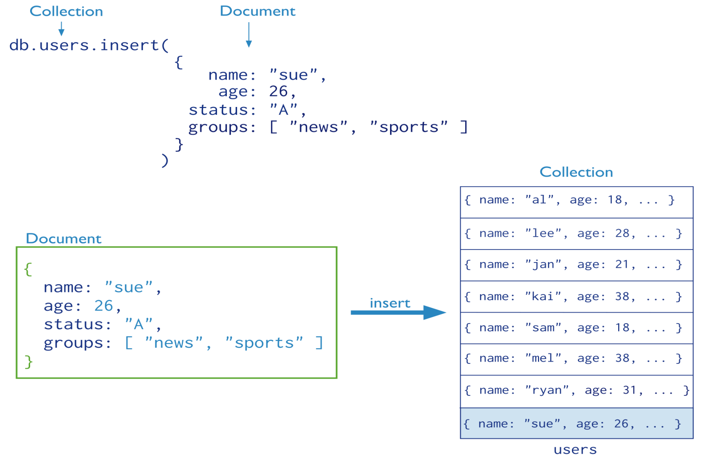
Insertion
Creating, Updating and Modifying No SQL Data Stores(CO5)
The collection “users” is created automatically if it does not exist

Slide 82
Multi-Document Insertion (Use of Arrays)
Continued
All the documents are inserted at once

Slide 83
Multi-Document Insertion (Bulk Operation)
Continued
A temporary object in memory
Holds your insertions and uploads them at once
There is also Bulk Ordered object
_id column is added automatically

Slide 84
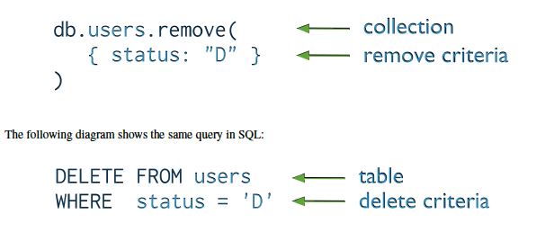
Deletion (Remove Operation)
Continued
You can put condition on any field in the document (even _id)
db.users.remove ( )
Removes all documents from users collection

Slide 85
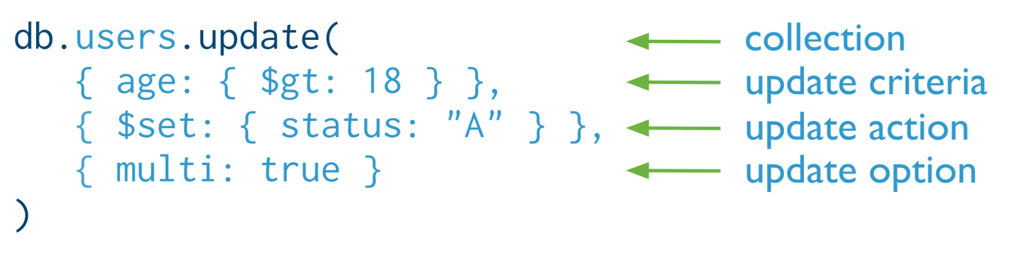

Update
Continued
Otherwise, it will update only the 1st matching document
Equivalent to in SQL:

Slide 86
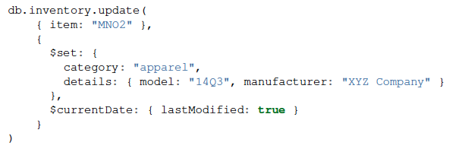
Update (Cont’d)
Continued
Two operators

Slide 87
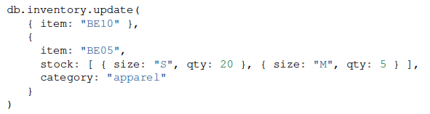
Replace a document
Continued
Query Condition
New
doc
For the document having item = “BE10”, replace it with the given document

Slide 88
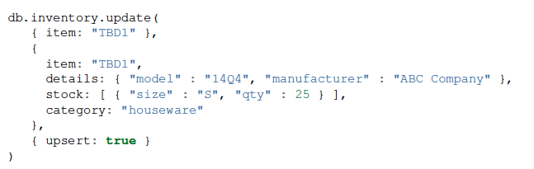
Insert or Replace
Continued
The upsert option
If the document having item = “TBD1” is in the DB, it will be replaced
Otherwise, it will be inserted.

Slide 89
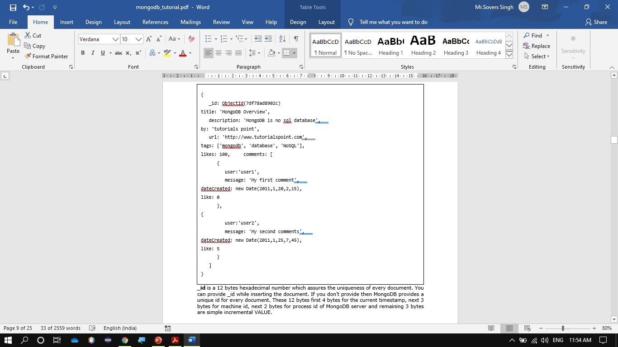
Continued
Any relational database has a typical schema design that shows number of tables and the relationship between these tables. While in MongoDB, there is no concept of relationship.

Slide 90
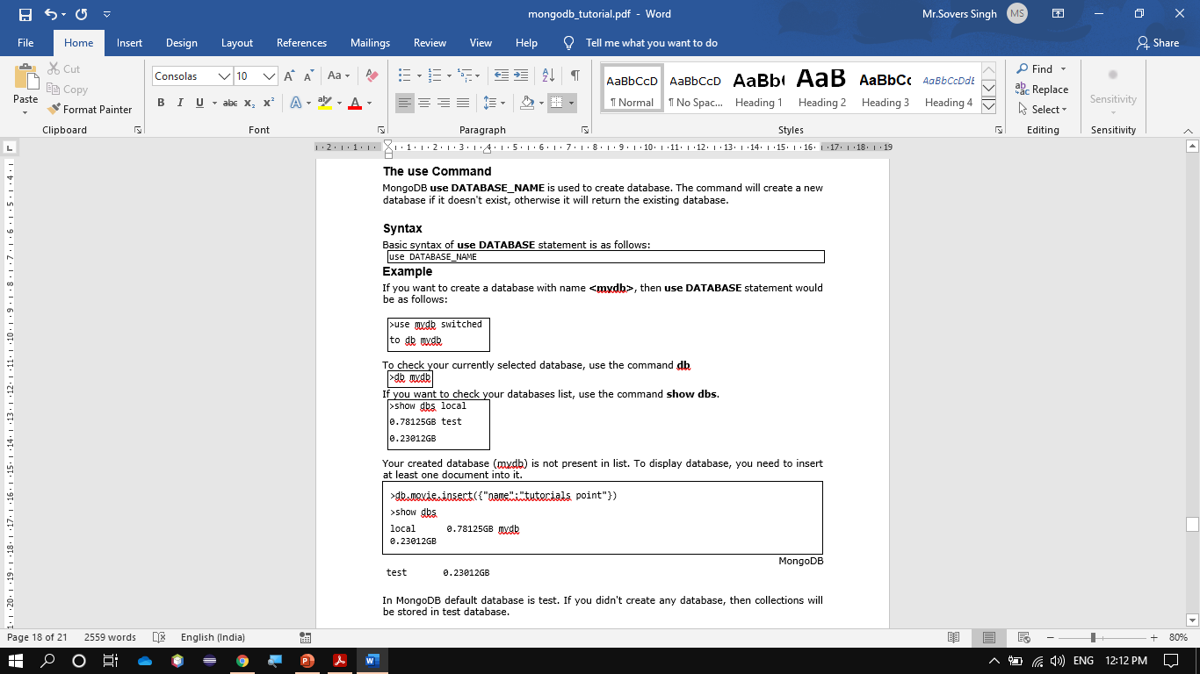
MongoDB Create Database
Continued

Slide 91
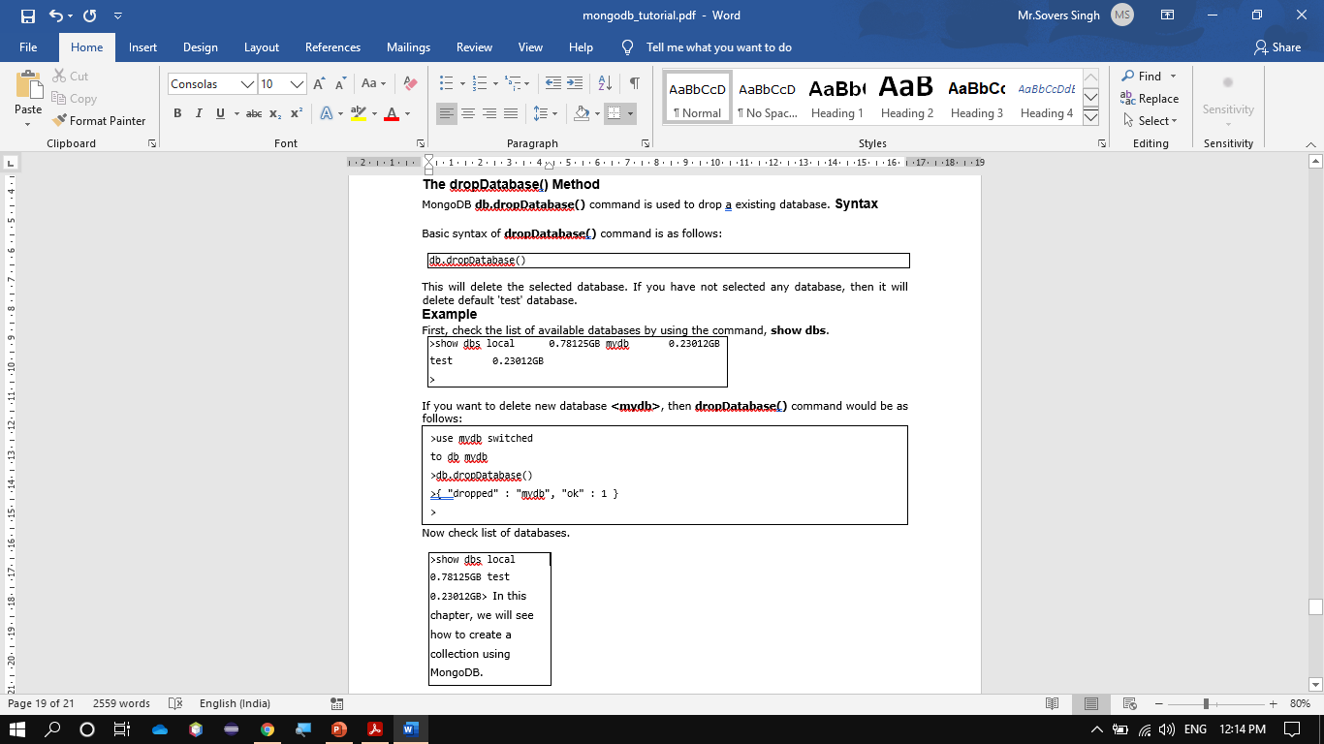
MongoDB Drop Database
Continued

Slide 92
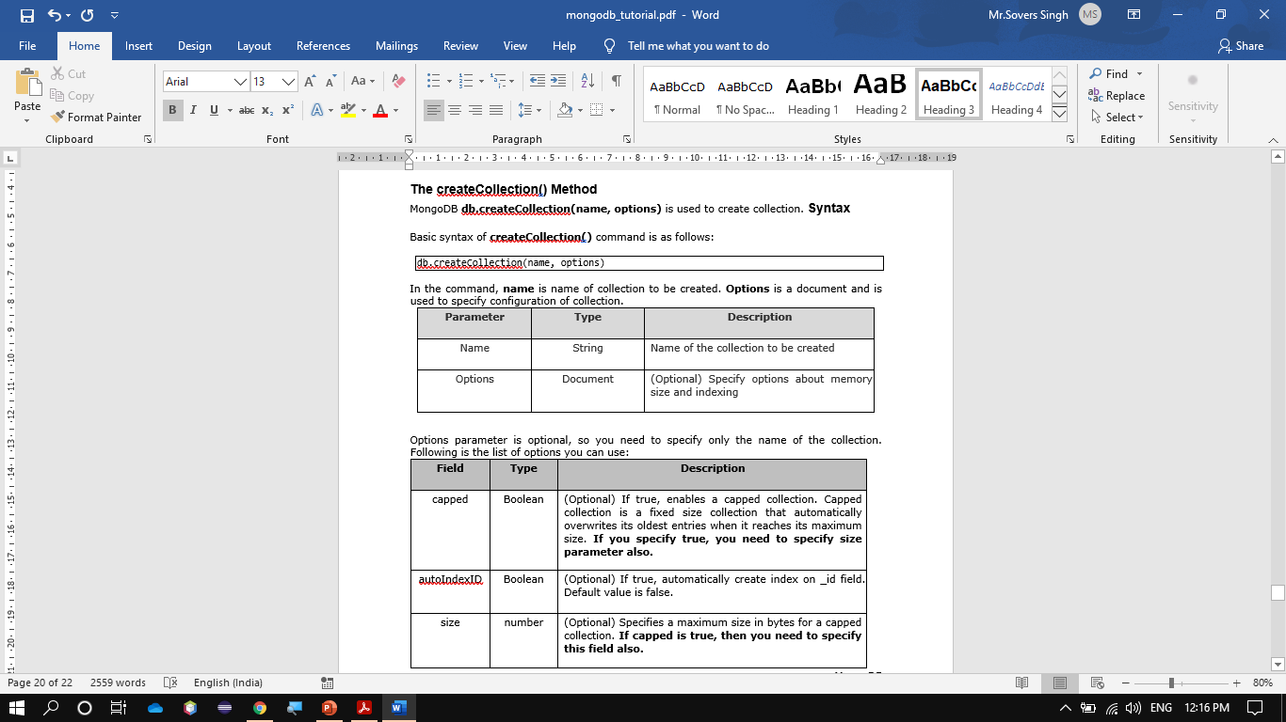
MongoDB Create Collection
Continued

Slide 93
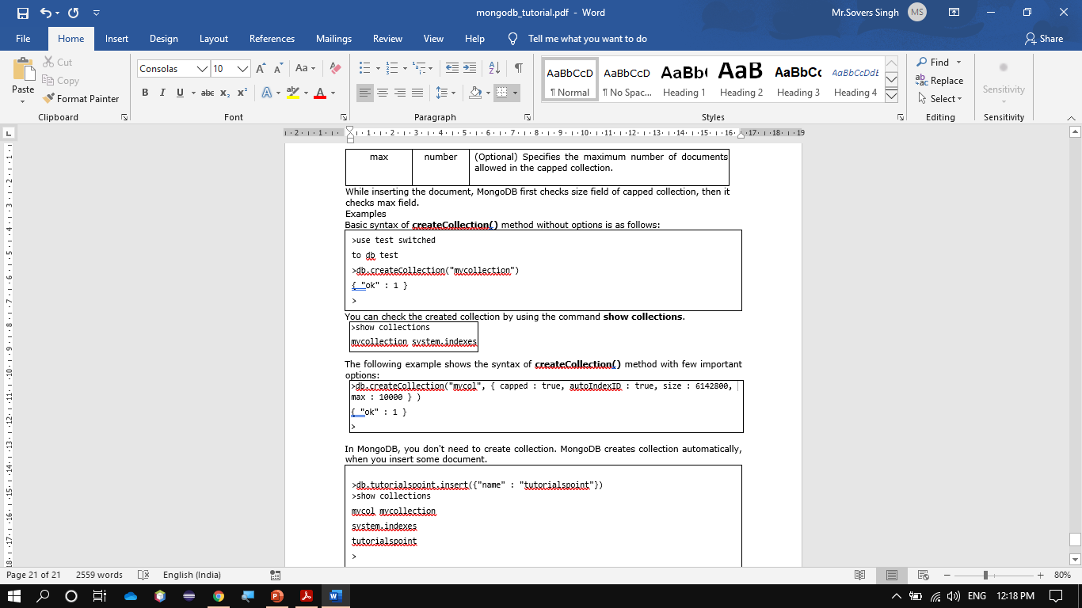
Continued

Slide 94
Topic 8 Objectives
Objective:
In this topic we focus on MongoDB uses multikey indexes to index the content stored in arrays. When you index on a column that holds an array value, MongoDB creates separate index entries for every element of the array. These multikey indexes allow queries to select documents that contain arrays by matching on element or elements of the arrays.

Slide 95
Indexing and Ordering Datasets(CO5)
Indexes support the efficient resolution of queries. Without indexes, MongoDB must scan every document of a collection to select those documents that match the query statement. This scan is highly inefficient and require MongoDB to process a large volume of data.
Indexes are special data structures, that store a small portion of the data set in an easy-to-traverse form. The index stores the value of a specific field or set of fields, ordered by the value of the field as specified in the index.
The createIndex() Method
To create an index, you need to use createIndex() method of MongoDB.
Syntax
The basic syntax of createIndex() method is as follows().
>db.COLLECTION_NAME.createIndex({KEY:1})
Here key is the name of the field on which you want to create index and 1 is for ascending order. To create index in descending order you need to use -1.

Slide 96
Example
>db.mycol.createIndex({"title":1})
{
"createdCollectionAutomatically" : false,
"numIndexesBefore" : 1,
"numIndexesAfter" : 2,
"ok" : 1
}
>
In createIndex() method you can pass multiple fields, to create index on multiple fields.
>db.mycol.createIndex({"title":1,"description":-1})
>

Slide 97
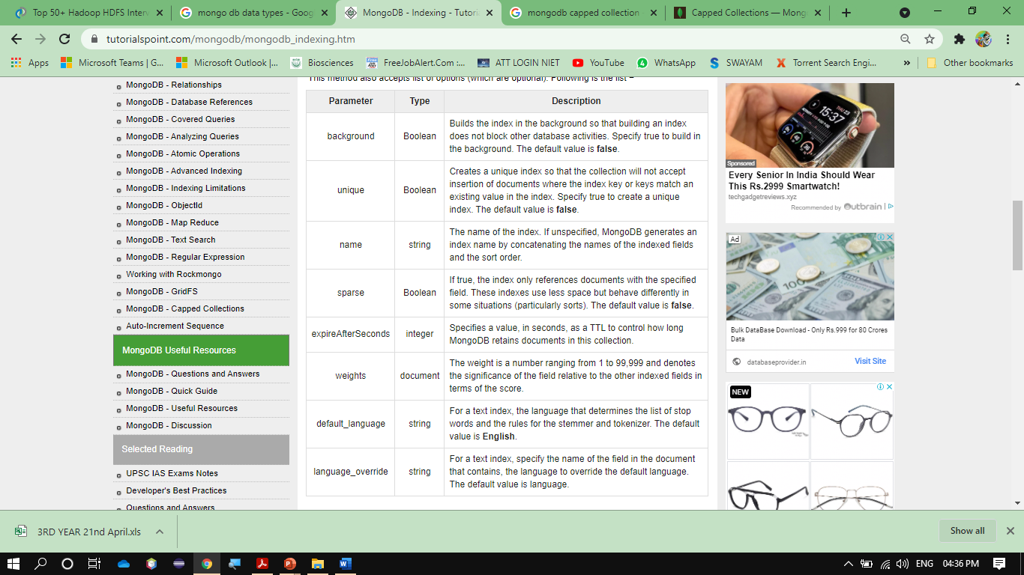
Continued

Slide 98
Continued
The dropIndex() method
You can drop a particular index using the dropIndex() method of MongoDB.
Syntax
The basic syntax of DropIndex() method is as follows:
>db.COLLECTION_NAME.dropIndex({KEY:1})
Here key is the name of the field on which you want to create index and 1 is for ascending order. To create index in descending order you need to use -1.
Example
> db.mycol.dropIndex({"title":1})
{
"ok" : 0,
"errmsg" : "can't find index with key: { title: 1.0 }",
"code" : 27,
"codeName" : "IndexNotFound"
}
The dropIndexes() method
This method deletes multiple (specified) indexes on a collection.
Syntax
The basic syntax of DropIndexes() method is as follows:

Slide 99
Continued
>db.COLLECTION_NAME.dropIndexes()
Example
Assume we have created 2 indexes in the named mycol collection as shown below −
> db.mycol.createIndex({"title":1,"description":-1})
Following example removes the above created indexes of mycol −
>db.mycol.dropIndexes({"title":1,"description":-1})
{ "nIndexesWas" : 2, "ok" : 1 }
>The getIndexes() method
This method returns the description of all the indexes in the collection.
Syntax
Following is the basic syntax of the getIndexes() method −
db.COLLECTION_NAME.getIndexes()
Example
Assume we have created 2 indexes in the named mycol collection as shown below −
> db.mycol.createIndex({"title":1,"description":-1})

Slide 100
Topic 9 Objectives
Objective:
In this topic we focus on Capped collections are fixed-size collections that support high-throughput operations that insert and retrieve documents based on insertion order.

Slide 101
Capped Collection(CO5)
Capped collections are fixed-size collections that support high-throughput operations that insert and retrieve documents based on insertion order. Capped collections work in a way similar to circular buffers: once a collection fills its allocated space, it makes room for new documents by overwriting the oldest documents in the collection.
Capped collections guarantee preservation of the insertion order. As a result, queries do not need an index to return documents in insertion order. Without this indexing overhead, capped collections can support higher insertion throughput.
To make room for new documents, capped collections automatically remove the oldest documents in the collection without requiring scripts or explicit remove operations.
Store log information generated by high-volume systems. Inserting documents in a capped collection without an index is close to the speed of writing log information directly to a file system. Furthermore, the built-in first-in-first-out property maintains the order of events, while managing storage use.
Cache small amounts of data in a capped collections. Since caches are read rather than write heavy, you would either need to ensure that this collection always remains in the working set (i.e. in RAM) or accept some write penalty for the required index or indexes.

Slide 102
Continued
_id Index
Capped collections have an _id field and an index on the _id field by default.
Restrictions and Recommendations
Updates
If you plan to update documents in a capped collection, create an index so that these update operations do not require a collection scan.
Document Size
Changed in version 3.2.
If an update or a replacement operation changes the document size, the operation will fail.
Document Deletion
You cannot delete documents from a capped collection. To remove all documents from a collection, use the drop() method to drop the collection and recreate the capped collection.
Sharding
You cannot shard a capped collection.
Query Efficiency
Use natural ordering to retrieve the most recently inserted elements from the collection efficiently. This is similar to using the tail command on a log file.
Aggregation $out
The aggregation pipeline stage $out cannot write results to a capped collection.
Transactions
Starting in MongoDB 4.2, you cannot write to capped collections in transactions. Reads from capped collections are still supported in transactions.

Slide 103
Continued
Procedures
Create a Capped Collection
You must create capped collections explicitly using the db.createCollection() method, which is a helper in the mongo shell for the create command. When creating a capped collection you must specify the maximum size of the collection in bytes, which MongoDB will pre-allocate for the collection. The size of the capped collection includes a small amount of space for internal overhead.
db.createCollection( "log", { capped: true, size: 100000 } )
If the size field is less than or equal to 4096, then the collection will have a cap of 4096 bytes. Otherwise, MongoDB will raise the provided size to make it an integer multiple of 256.
Additionally, you may also specify a maximum number of documents for the collection using the max field as in the following document:
db.createCollection("log", { capped : true, size : 5242880, max : 5000 } )

Slide 104
Continued
Query a Capped Collection
If you perform a find() on a capped collection with no ordering specified, MongoDB guarantees that the ordering of results is the same as the insertion order.
To retrieve documents in reverse insertion order, issue find() along with the sort() method with the $natural parameter set to -1, as shown in the following example:
db.cappedCollection.find().sort( { $natural: -1 } )
Check if a Collection is Capped
Use the isCapped() method to determine if a collection is capped, as follows:
db.collection.isCapped()
Convert a Collection to Capped
You can convert a non-capped collection to a capped collection with the convertToCapped command:
db.runCommand({"convertToCapped": "mycol", size: 100000});

Slide 105
Continued
The size parameter specifies the size of the capped collection in bytes.
This holds a database exclusive lock for the duration of the operation. Other operations which lock the same database will be blocked until the operation completes. See What locks are taken by some common client operations? for operations that lock the database.
Tailable Cursor
You can use a tailable cursor with capped collections. Similar to the Unix tail -f command, the tailable cursor "tails" the end of a capped collection. As new documents are inserted into the capped collection, you can use the tailable cursor to continue retrieving documents.

Slide 106
Topic 10 Objectives
Objective:
In this topic we focus on cloud database which is a database service built and accessed through a cloud platform. It serves many of the same functions as a traditional database with the added flexibility of cloud computing. Users install software on a cloud infrastructure to implement the database.

Slide 107
Introduction to Cloud Database(CO5)
A cloud database is a database service built and accessed through a cloud platform. It serves many of the same functions as a traditional database with the added flexibility of cloud computing. Users install software on a cloud infrastructure to implement the database.
Key features:
A database service built and accessed through a cloud platform
Enables enterprise users to host databases without buying dedicated hardware
Can be managed by the user or offered as a service and managed by a provider
Can support relational databases (including MySQL and PostgreSQL) and NoSQL databases (including MongoDB and Apache CouchDB)
Accessed through a web interface or vendor-provided API.

Slide 108
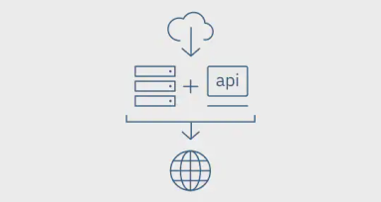
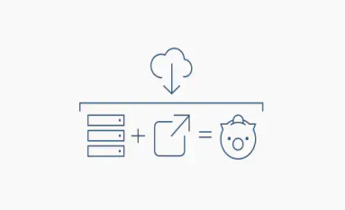
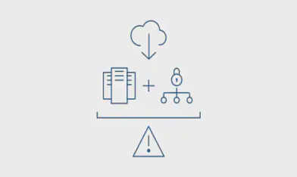
Continued
Why cloud databases
Ease of access
Users can access cloud databases from virtually anywhere, using a vendor’s API or web interface.
Scalability
Cloud databases can expand their storage capacities on run-time to accommodate changing needs. Organizations only pay for what they use.
Disaster recovery
In the event of a natural disaster, equipment failure or power outage, data is kept secure through backups on remote servers.

Slide 109
Continued
Considerations for cloud databases
Control options
Users can opt for a virtual machine image managed like a traditional database or a provider’s database as a service (DBaaS).
Database technology
SQL databases are difficult to scale but very common. NoSQL databases scale more easily but do not work with some applications.
Security
Most cloud database providers encrypt data and provide other security measures; organizations should research their options.
Maintenance
When using a virtual machine image, one should ensure that IT staffers can maintain the underlying infrastructure.

Slide 110
Cloud Database(CO5)
WHAT IS A CLOUD DATABASE?
let’s dig deeper into the cloud-based world that we are living in. So, cloud database services include everything from storing all kinds of data required to providing access and delivering the data to the required parties involved. Therefore, as mentioned above, it is storing the data on the internet and is normally of three kinds.
Platform as a service(PaaS)
Software as a service(SaaS)
Infrastructure as a service(IaaS)
Platform as a service or PaaS is the most common type here, providing the provision of servers, data storage, and operating systems. It helps in the storage and acts as a platform for the virtual database, saving the hardware cost and helping to access the data from all around the world.
SaaS, on the other hand, provides the entire software as a service to the organization in exchange for an amount and is an excellent business option for all those organizations involving a lot of web users.
IaaS helps to provide a complete infrastructure where the business can run their applications.

Slide 111
Continued
CLOUD DATABASE TECHNOLOGIES LIST
CLOUCloud computing is on a rise because of the flexibility and the ease of services that it provides. Several well-known IT giants are planning to capture the market. Most of the cloud databases run on the well-known cloud computing platforms like Rackspace, salesforce, GoGrid, and Amazon EC2.
Here are the top five most beneficial cloud services for data storage.
Amazon Web Services or AWS- AWS needs no introduction as it is already counted as one of the top cloud database technologies.
Azure by Microsoft- This is Microsoft’s entry into the cloud space which has already gained a lot of momentum.
Oracle Database cloud- Everyone has heard about Oracle because of its traditional database system, and now it is capturing the cloud storage space.
SAP- SAP is the giant when it comes to offering software for enterprises and now is ready for cloud storage with its platform called HANA.D DATABASE TECHNOLOGIES LIST.

Slide 112
Topic 11 Objectives
Objective:
In this topic we focus on NoSQL databases are specifically designed for low cost commodity hardware. These databases are mostly used for storage and access of data across multiple storage cluster. For example Google, Facebook, Google+, Google big table, Amazon Dynamo, Twitter etc. collects and stores Terabytes of data for their user every day.

Slide 113
No SQL with Cloud Database(CO5)
What is a cloud database?
A “cloud database” can be one of two distinct things: a traditional or NoSQL database installed and running on a cloud virtual machine (be it public cloud, private cloud, or hybrid cloud platforms), or a cloud provider’s fully managed database-as-a-service (DBaaS) offering. The former, running your own self-managed database in a cloud environment, is really no different from operating a traditional database. Cloud DBaaS, on the other hand, is the natural database equivalent of software-as-a-service (SaaS): pay as you go, and only for what you use, and let the system handle all the details of provisioning and scaling to meet demand, while maintaining consistently high performance.
Cloud database options:
Traditional database running on cloud virtual machine (VM)
Fully managed database-as-a-service
Most of the time (and for most of the remainder of this page), the
term “cloud database” refers to a cloud-based database-as-a-service.

Slide 114
Continued
Why use a cloud database/DBaaS?
The key benefits of cloud databases are that they are accessible from anywhere, scalable from day one, and designed for reliability and performance.
Common cloud database use cases
Cloud databases work in most cases that traditional databases do. They are particularly valuable when building software products that:
Are cloud-native
Require large volume of data
Need to handle high scale traffic
Are distributed geographically
Data applications that take advantage of centralization, like legacy modernization and analytics, are also fantastic candidates for cloud database usage.
While certain use cases are more obvious candidates for cloud database usage, more traditional use cases, like real-time online transaction processing, caching, or data warehousing work just as well in the fully managed paradigm.

Slide 115
Continued
Cloud database considerations
Whether you’re still thinking about whether a cloud database is right for you, or in the process of selecting the ideal database-as-a-service for your needs, there are a few key factors to take into consideration:
Cloud Database Providers
Database Technology
Management System
Cost Model
Security
Extras

Slide 116
Continued
Continued
MongoDB Atlas cloud database
MongoDB can be installed and run on any cloud provider or on-premise network as a self-managed database cluster or virtual machine, or on AWS, GCP, or Azure using MongoDB Atlas, our cloud database-as-a-service (DBaaS) offering. There are major benefits to adopting the DBaaS option, including:
Simplified management
Elastic autoscaling
Redundancy, backup, and restore
Charts
Connectors
Schema navigator

Slide 117
NoSQL with Cloud Database (CO5)
Continued
MongoDB Atlas, part of MongoDB’s broader data-as-a-service (DaaS) development platform, is a powerful and compelling alternative to managing your own NoSQL, or traditional, database, or using a cloud provider-specific managed offering.
The way a cloud database works is that rather than installing, configuring, and maintaining a database instance or instances, an automated system is able to provision, manage, and scale the underlying database cluster for you.
Fully managed database services handle the complexities of maintaining a consistently available, high performance cluster in a way that allows you, the developer, to access it as a simple, globally available resource.
You can treat the cluster as a single database instance, covered by a transparent usage-based pricing model, so you’re never worrying about over- or under-provisioning.

Slide 118
Topic 12 Objectives
Objective:
In this topic we focus on cloud database which is a database service built and accessed through a cloud platform. It serves many of the same functions as a traditional database with the added flexibility of cloud computing. Users install software on a cloud infrastructure to implement the database.

Slide 119
Introduction to Real time database System(CO5)
Real-Time Data Base System can be defined as those computing systems that are designed to operate in a timely manner.
It must perform certain actions within specific timing constrains (producing results while meeting predefined deadlines)
Real-Time Data Base System can also be defined as Traditional Databases that uses an extension to give additional power to yield reliable response.

Slide 120
Continued
Typical Real-Time Bata Base System consists of:
Controlled System : the underlying application
Controlling System:
A Computer monitoring the state of the environment
Supplying the environment with the appropriate driving
signals.
The state of the environment as perceived by the controlling system must be consistent with the actual state of the environment.

Slide 121
Specifications
Continued
validity of data
Effective RTBDS must consider:
Temporal-consistency: maintaining consistency between the actual state of the environment and the state as reflected or perceived by the system.
Deadlines: timing constrains which must be met in addition to the desired computations
Priority Scheduling: policy for ordering the execution of the outstanding processor according to some predefined criteria.
As a conclusion, Real Time Data Base Systems correctness do not only depends on the logical correctness, but on the timeliness of its actions
integrity of data

Slide 122
Services and Examples
Introduction to Real time Database (CO5)
Continued
Telecommunication Systems
Routers and network management systems
Telephone switching systems
Control Systems
Automatic tracking and object positioning
Engine control in automobiles
Multimedia servers for real-time streaming
E-commerce and e-buisness
Stock market: program stock trading
Financial services: credit card transactions
Web-based data services

Slide 123
System Models and Timing Deadlines
Continued
Soft-Deadline:
desirable but not critical
missing a soft-deadline does not cause a system failure or compromises the system’s integrity
Example: operator switchboard for a telephone
v(t)
Soft deadline
v₀
d₁
d₂
t

Slide 124
Deadlines
Introduction to Real time Database (CO5)
Continued
Firm-Deadline:
Desirable but not critical (like Soft-Deadline case)
It is not executed after its deadline and no value is gained by the system from the tasks that miss their deadlines
Example: an autopilot system
v(t)
Firm deadline
v₀
d
t

Slide 125
Deadlines
Continued
Hard-Deadline:
Timely and logically correct execution is considered to be critical
Missing a hard-deadline can result in catastrophic consequences
Also known as Safety-Critical
Example: data gathered by a sensor
v(t)
Hard deadline
v₀
d
t

Slide 126
Design Paradigms
Continued
Time-Triggered (TT)
Systems are initiated as predefined instances
Assessments of resource requirements and resource availability is required
TT architecture can provide predictable behavior due to its pre-planed execution pattern.

Slide 127
Design Paradigms
Introduction to Real time Database (CO5)
Continued
Event-Triggered (ET)
Systems are initiated in response to the occurrence of particular events that are possibly caused by the environment
The resource-need assessments in ET architecture is usually probabilistic
ET is not as reliable as TT but provides more flexibility and ideal for more classes of applications
ET behavior usually is not predictable.

Slide 128
Tasks Periodicity
Continued
Prosodic Tasks
Executes at regular intervals of time
Corresponds to TT architecture
Have Hard-Deadlines characterized by their periods (requires worst-case analysis).
Aperiodic Tasks
Execution time cannot be priori anticipated
Activation of tasks is random event caused by a trigger
Corresponds to ET architecture
Have Soft-Deadlines (no worst-case analysis)

Slide 129
Tasks Periodicity
Continued
Sporadic Tasks
Tasks which are aperiodic in nature, but have Hard-Deadlines
Used to handle emergency conditions or exceptional situations
Worst-case calculations is done using Schedulability-Constraint
Schedulability-Constraint defines a minimum period between any two sporadic events from the same source.

Slide 130
Scheduling
Continued
Each task within a real-time system has
Deadline
An arrival time
Possibly an estimated worst-case execution
A Scheduler can be defined as an algorithm or policy for ordering the execution of the outstanding process
Scheduler maybe:
Preemptive
Can arbitrarily suspend and resume the execution of the task without affecting its behavior

Slide 131
Scheduling (Cont)
Continued
Non-preemptive
A task must be rum without interruption until completion
Hybrid
Preemptive scheduler, but preemption is only allowed at certain points within the code of each task.
Real-Time scheduling algorithms can be :
Static
Known as fixed-priority where priorities are computed off-line
Requires complete priori knowledge of the real-time environment in which is deployed
Inflexible: scheme is workable only if all the tasks are effectively periodic.
Can work only for simple systems, performs inconsistently as the load increases.

Slide 132
Scheduling (Cont)
Continued
Dynamic
Assumes unpredictable task-arrival times
Attempts to schedule tasks dynamically upon arrival
Dynamically computes and assigns a priority value to each task
Decisions are based on task characteristics and the current state of the system
Flexible scheduler that can deal with unpredictable events.

Slide 133
Priority-Based Scheduling
Continued
Conventional scheduling algorithms aims at balancing the number of CPU-bound and I/O bound jobs to maximize system utilization and throughput
Real-Time tasks need to be scheduled according to their criticalness and timeliness
Real-Time system must ensure that the progress of higher-priority tasks (ideally) is never hindered by lower-priority tasks.

Slide 134
Priority-Based Scheduling Methods
Continued
Earliest-Deadline-First (EDF):
the task with the current closest (earliest) deadline is assigned the highest priority in the system and executed next
Value-Functions : highest value (benefit) first
the scheduler is required to assign priorities as well as defining the system values of completing each task at any instant in time

Slide 135
Priority-Based Scheduling Methods
Continued
Value-Density (VD): highest (value/computation) first
The scheduler tends to select the tasks that earn more value per time unit they consume
It is a greedy technique since it always schedules that task that has the highest expected value within the shortest possible time unit.
Complex functions of deadline, value and slack time.

Slide 136
Synchronization
Continued
Priority inversion problem: a higher-priority task can be blocked by a lower-priority task possibly for an unbounded number of times and for unbounded periods.
Solutions:
The Priority Inheritance Protocol
execute the blocking transaction (low priority) with the priority of the blocked transaction (high priority)
The task inherits the highest priority level of all the tasks it blocks and executes its resource (critical section)
“intermediate” blocking is eliminated

Slide 137
Synchronization (Cont)
Continued
Priority Abort Protocol
abort the low priority transaction - no blocking at all
quick resolution, but wasted resources
Conditional Priority Inheritance Protocol
based on the estimated length of transaction
inherit the priority only if blocking one is close to completion; otherwise abort.

Slide 138
Real Time Database Systems Overview
Continued
Topics related to design of RTDBS in a centralized uni-processor system:
RTDBS System Models
Scheduling RTDB Transactions
Concurrency Control
Conflict Resolution
Deadlocks
Admission Control
Memory Management
I/O and Disk Scheduling

Slide 139
Conventional Databases: Transactions and Serializability
Continued
Transaction: is a collection of read and write operations which comprises a consistent transformation of the system state.
When executed alone, each transaction transforms a consistent state into a new consistent state
Transactions preserve consistency of the database information
Schedule: a particular sequencing of the actions from different transactions.
Consistent Schedule: a schedule that gives each transaction a consistent view of the database-state.

Slide 140
Conventional Databases: Transactions and Serializability
Continued
Database inconsistencies can be caused by:
Failures
Concurrency
Four properties associated with transactions known as ACID properties are used to prevent such problems

Slide 141
Conventional Databases: ACID Properties
Introduction to Real Time Database(CO5)
A Atomicity: Either all or none of the transactions operations are/is performed. All the operations of a transaction are treated as a single, indivisible, atomic unit.
C Consistency: A transaction maintains the integrity constraints on the database.
I Isolation: Transactions can execute concurrently but with no interference with each other’s operations.
D Durability: All changes made by a committed transaction become permanent in the database, surviving any subsequent failures.

Slide 142
Conventional Databases: ACID Properties (Cont.)
Continued
Consistency of database is preserved by each transaction
Recovery Protocols are used to ensure the Atomicity and Durability properties
The difficulty of dealing with traditional transactions that different execution paths have significantly different requirement
Concurrent execution may violate the database integrity constrains regardless of the correctness of individual transactions.

Slide 143
Serializability
Continued
An execution is said to be serializiable if it produces the same output and has the same effect on the database as some serial execution of the same transactions.
Serializability is a notion of correctness in any DBMS
Conflict-Serializability:
the simplest and most common form of Serializability
ensures that conflicting operations appear in the same order in two equivalent executions
Conflicts can happen in case of read and write operations on the same data object.
View Serializability
Two executions are equivalent if each transaction reads the same values in the two executions.
Final value of the databases is the same in both executions

Slide 144
Recoverable History
Continued
Cascading-Aborts: If a transaction Tj reads a value that was last written by an aborted transaction Ti, then Tj must also be aborted
To keep Durability, once a transaction commits, it could not subsequently be aborted nor its effects changed due to cascading-aborts.
to assure Atomicity and Durability, an execution must be Recoverable
An execution is Recoverable if, once a transaction is committed, the transaction is guaranteed not to be involved in cascading aborts.

Slide 145
Recoverable History (Cont)
Continued
Cascadeless: Read only committed written data. That is, if transaction Tj reads from Ti, then Ti must be an already committed transaction; i.e.,
Wi [x] → Rj [x] ⇒ Ci → Cj
Strict: Read and write only committed written data. That is, if transaction Tj reads from Ti, or overwrites a data item that was last written by Ti, then Ti must be an already committed transaction; i.e.,
Wi [x] → Rj [x] ⇒ Ci → Cj
Wj [x] ⇒ Ci → Cj

Slide 146
RTBBS vs. Conventional DB
Continued
Real-Time Transactions
Logically correct and consistent (ACID)
“Approximately correct”
trade quality or correctness for timeliness
Time correctness
time constraints on transactions
temporal constraints on data
Conventional Transactions
Logically correct and consistent (ACID):
atomicity
consistency
isolation
durability

Slide 147
Conventional DB vs. RTDBS
Continued
Real-Time Database Systems:
Logical consistency
ACID properties (may be relaxed)
Data integrity constraints
Enforce time constraints
Deadlines of transaction
External consistency
absolute validity interval (AVI)
Temporal consistency
relative validity interval (RVI)
Conventional Databases:
Logical consistency
ACID properties of transactions:
Atomicity
Isolation
Consistency
Durability
Data integrity constraints

Slide 148
Conventional DB vs. RTDBS
Continued
Real-time systems
Task centric
Deadlines attached to tasks
Real-time databases
Data centric
Data has temporal validity, i.e., deadlines also attached to data
Transactions must be executed by deadline to keep the data valid, in addition to produce results in a timely manner

Slide 149
A Real-Time Database Model
Continued

Slide 150
A Real-Time Database Model
Continued
Any new transaction must pass through an Admission Control mechanism, which monitors and regulates the total number of concurrently active transactions within the system in order to avoid thrashing
Every new or resubmitted transaction is assigned a Priority Level, which orders its scheduling preference relative to the other concurrent transactions within the system
Before a transaction performs an operation on a data object, it must go through the Concurrency Control component in order to achieve the required synchronization. If the transaction’s request for a granule is denied, the transaction will be placed into a Wait Queue.
The waiting transaction will be reactivated when the requested granule becomes available, after which the transaction performs its operation.

Slide 151
A Real-Time Database Model
Continued
Similarly, if a transaction requests an item that is currently not in main-memory, an I/O request is initiated and the transaction will be placed into a wait queue.
The waiting transaction will be reactivated when the requested granule becomes available in main-memory, and there is no active higher-priority transaction.
When a transaction completes all of its operations, it commits its result(s) and releases all of the data items in its possession.

Slide 152
A Real-Time Database Model
Continued
A transaction may abort/restart a number of times before it commits. There are various types of aborts :
Terminating abort:
An abort due to missing a deadline, or
Self-abort – a transaction may abort itself due to an exceptional condition.
Non-terminating abort: An abort due to a deadlock or a data conflict. In this case, the transaction maybe restarted if its deadline remains feasible.

Slide 153
Scheduling RTDB Transactions
Continued
A special feature of RTDB systems, in addition to standard physical resources, is the data objects stored in the database, and transactions accessing this data have to be scheduled in accordance with real-time performance objectives.
The scheduling process of transactions in a RTDB system consists of:
Concurrency Control
Conflict Resolution

Slide 154
Scheduling RTDB Transactions
Continued
Concurrency Control Protocols
Locking
Time-stamping
Multiversion
Validation
all of which have the same goal; i.e., enforcing serializability.
These Protocols need to be modified and their trade-off(s) must be reevaluated under RTDB systems.

Slide 155
Scheduling RTDB Transactions Concurrency Control Protocol
Continued
Locks are used to synchronize concurrent actions
Two-Phase Locking (2PL)
all locking operations precedes the first unlock operation in the transaction
expanding phase (locks are acquired)
shrinking phase (locks are released)
suffers from deadlock
priority inversion

Slide 156
Scheduling RTDB Transactions Conflict Resolution Protocol
Continued
Conflict Resolution Protocol
Priority-based Wound-Wait Conflict Resolution
The original scheme was designed to use timestamps.
It was modified so that the scheme uses priorities instead of timestamps
Modified scheme known as High-Priority (HP) and as Priority-Abort (PA)

Slide 157
Continued
Scheduling RTDB Transactions Deadlocks
Deadlocks
Whenever a set of transactions gets involved in a circular wait in what is known as a wait-for graph
Five deadlock resolution policies that take into account :
the timing properties of the transactions
the cost of abort operations

Slide 158
Scheduling RTDB Transactions Deadlocks
Continued
Policy 1:
Always aborts the transaction invoking deadlock detection.
Policy 2:
Trace the deadlock cycle
abort the first tardy transaction encountered in a deadlock cycle.
If no tardy transaction is found, abort the transaction with the furthest deadline.
Policy 3:
Trace the deadlock cycle
abort the first tardy transaction encountered in a deadlock cycle.
If no tardy transaction is found, abort the transaction with the earliest deadline.

Slide 159
Scheduling RTDB Transactions Deadlocks
Continued
Policy 4:
Trace the deadlock cycle, and abort the first tardy transaction encountered in a deadlock cycle.
If no tardy transaction is found, abort the transaction with the least criticalness.
Policy 5:
Abort the infeasible transaction with the least criticalness.
If all transactions are feasible, then abort a feasible transaction with the least criticalness.
This policy is sensitive to the accuracy of the computation time because it requires information about remaining execution time
So; Total execution time requirements at the start of each transaction must be known.

Slide 160
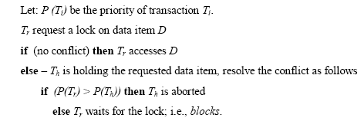
Scheduling RTDB Transactions Conflict Resolution Protocol
Continued
Outline of the Protocol:

Slide 161
Scheduling RTDB Transactions Admission Control
Continued
Admission Controller:
Reject transaction
Admit contingency action
Scheduler:
Drop transaction (firm/soft)
Replace transaction with contingency action (hard)
Postpone transaction execution (soft)

Slide 162
Scheduling RTDB Transactions Memory Management
Continued
Memory management is concerned with three types of decisions:
transaction admission
buffer allocation
buffer replacement

Slide 163
Future Research Areas in RTDBS
Continued
Resource management and scheduling
Recovery
Concurrency Control
Fault tolerance and security models to interact with RTDBS
Query languages for explicit specification of real-time constraints -> RT-SQL
Distributed real-time databases
Data models to support complex multimedia objects
Schemes to process a mixture of hard, soft, and firm timing constraints and complex transaction structures
Support for more active features in real-time context
Interaction with legacy systems (conventional databases)

Slide 164

Daily Quiz 1

Slide 165
Daily Quiz 2
1. Point out the correct statement.
a) Documents can contain many different key-value pairs, or key-array pairs, or even nested documents
b) MongoDB has official drivers for a variety of popular programming languages and development environments
c) When compared to relational databases, NoSQL databases are more scalable and provide superior performance
d) All of the mentioned
2. Point out the wrong statement.
a) Non Relational databases require that schemas be defined before you can add data
b) NoSQL databases are built to allow the insertion of data without a predefined schema
c) NewSQL databases are built to allow the insertion of data without a predefined schema
d) All of the mentioned

Slide 166
Daily Quiz
3. When you query a collection, MongoDB returns a ________ object that contains the results of the query.
a) row
b) cursor
c) colums
d) none of the mentioned
4. Point out the wrong statement.
a) Documents have static schema in MongoDB
b) Eventually-consistent reads can be distributed over replicated servers
c) Indexes can include keys from embedded documents and arrays
d) None of the mentioned
5. The __________ method limits the number of documents in the result set.
a) limit()
b) limitOf()
c) limitBy()
d) none of the mentioned

Slide 167
MCQs
1. Most NoSQL databases support automatic __________ meaning that you get high availability and disaster recovery.
(a) processing
(b) scalability
(c) replication
(d) all of the mentioned
2. Which of the following are the simplest NoSQL databases?
(a) Key-value
(b) Wide-column
(c) Document
(d) All of the mentioned
3.________ stores are used to store information about networks, such as social connections.
(a) Key-value
(b) Wide-column
(c) Document
(d) Graph

Slide 168
MCQs
4. NoSQL databases is used mainly for handling large volumes of ______________ data.
(a) unstructured
(b) structured
(c) semi-structured
(d) all of the mentioned
5. Which of the following language is MongoDB written in?
(a) Javascript
(b) C
(c) C++
(d) All of the mentioned
6. Point out the correct statement.
(a) MongoDB is classified as a NoSQL database
(b) MongoDB favors XML format more than JSON
(c) MongoDB is column-oriented database store
(d) All of the mentioned

Slide 169
MCQs
7. Which of the following format is supported by MongoDB?
(a) SQL
(b) XML
(c) BSON
(d) All of the mentioned
8. NoSQL was designed with security in mind, so developers or security teams don't need to worry about implementing a security layer. Is it true or false?
(a) True
(b) False
9. Which of the following is not a reason NoSQL has become a popular solution for some organizations?
(a) Better scalability
(b) Improved ability to keep data consistent
(c) Faster access to data than relational database management systems (RDBMS)
(d) More easily allows for data to be held across multiple servers
10. NoSQL prohibits structured query language (SQL). Is it True or False?
(a) True
(b) False

Slide 170
Weekly Assignment 1
Q1: What are NoSQL databases? What are the different types of NoSQL databases?(CO5)
Q2: What do you understand by NoSQL databases? Explain.(CO5)
Q3: Explain difference between scaling horizontally and vertically for databases.(CO5)
Q4: What are the advantages of NoSQL over traditional RDBMS?(CO5)
Q5: When should we embed one document within another in MongoDB?(CO5)
Q6: Define ACID Properties?(CO5)
Q7: Does MongoDB support ACID transaction management and locking functionalities?(CO5)
Q8: Explain advantages of BSON over JSON in MongoDB?(CO5)
Q9: How can you achieve primary key - foreign key relationships in MongoDB?(CO5)
Q10: How do I perform the SQL JOIN equivalent in MongoDB?(CO5)

Slide 171
Weekly Assignment 2
Q1: Differentiate between SQL and No SQL.(CO5)
Q2: Discuss the four different No SQL types.(CO5)
Q3:Explain CRUD operations in detail with suitable examples.(CO5)
Q4: Discuss CAP Theorem with suitable diagram.(CO5)
Q5: Discuss the role of indexing in No SQL databases and how it differs from indexing in relational databases.(CO5)

Slide 172

Glossary Questions
Fill the following blanks with one of the given options-

Slide 173
Old University Exam Question Papers
http://www.aktuonline.com/papers/btech-cs-5-sem-data-base-management-system-KCS501-2020.pdf
http://www.aktuonline.com/papers/btech-cs-5-sem-database-management-system-KCS-501-2018-19.pdf
http://www.aktuonline.com/papers/btech-cs-5-sem-database-management-system-ncs-502-2017-18.pdf
http://www.aktuonline.com/papers/btech-cs-5-sem-database-management-system-ncs-502-2016-17.pdf

Slide 174
Expected Questions for University Exam
1. What do you mean by NoSQL?
2. What are the features of NoSQL?
3. What is the CAP theorem? How is it applicable to NoSQL systems?
4. Explain the difference: RDBMS vs NoSQL?
5. What are the major challenges with traditional RDBMS?
6. What are the different types of NoSQL databases?
7. How Does NoSQL relate to big data?
8. Can you explain the transaction support by using a BASE in
NoSQL?
9. What is a Key-Value store or Key-Value database?
10. What is the Column store database?

Slide 175
Recap of Unit
This unit provide us fundamentals domain of NOSQL and its latest trends in industry.
In this unit we are also benefitted with the knowledge of different types of databases in NOSQL.
Whether you experience a natural disaster, power failure or other crisis, having your data stored in the cloud ensures it is backed up and protected in a secure and safe location. Being able to access your data again quickly allows you to conduct business as usual, minimizing any downtime and loss of productivity
This unit will impart us with knowledge of Cloud Databases and querying on cloud databases.

